Slide 1
PHP Training
Module 2 : PHP Basics

Slide 2
Content(s)
PHP Variables
PHP Constants
PHP Datatypes
PHP Operators
PHP Control Statements
PHP Functions
PHP Math Functions

Slide 3
PHP Variables?
In PHP, a variable is declared using a $ sign followed by the variable name.
As PHP is a loosely typed language, so we do not need to declare the data types of the variables. It automatically analyses the values and makes conversions to its correct datatype.
After declaring a variable, it can be reused throughout the code.
Assignment Operator (=) is used to assign the value to a variable.
Syntax of declaring a variable in PHP is given below:
$variablename = value;

Slide 4
Rules for declaring the variables?
Rules for declaring PHP variable:
A variable must start with a dollar ($) sign, followed by the variable name.
It can only contain alpha-numeric character and underscore (A-z, 0-9, _).
A variable name must start with a letter or underscore (_) character.
A PHP variable name cannot contain spaces.
One thing to be kept in mind that the variable name cannot start with a number or special symbols.
PHP variables are case-sensitive, so $name and $NAME both are treated as different variable.

Slide 5
Example: Declaring String, Integer and Float
Let's see the example to store string, integer, and float values in PHP variables.
File: variable1.php
<?php $str="hello string"; $x=200; $y=44.6; echo "string is: $str <br/>"; echo "integer is: $x <br/>"; echo "float is: $y <br/>"; ?>

Slide 6
PHP print and echo statements?
We frequently use the echo statement to display the output. There are two basic ways to get the output in PHP:
echo
print
echo and print are language constructs, and they never behave like a function. Therefore, there is no requirement for parentheses

Slide 7
Difference print and echo statements?
print | echo
print is also a statement, used as an alternative to echo at many times to display the output. print can be used with or without parentheses. print always returns an integer value, which is 1. Using print, we cannot pass multiple arguments. print is slower than echo statement. | echo is a statement, which is used to display the output. echo can be used with or without parentheses. echo does not return any value. We can pass multiple strings separated by comma (,) in echo. echo is faster than print statement.

Slide 8
Examples : echo and print ?
For Example (Check multiple arguments)
You can pass multiple arguments separated by a comma (,) in echo. It will not generate any syntax error
print | echo
<?php $fname = "Jesal"; $lname = "Desai"; print "My name is: ".$fname,$lname; ?> | <?php $fname = "Jesal"; $lname = "Desai"; echo "My name is: ".$fname,$lname; ?>

Slide 9
Examples : echo and print ?
For Example (Check Return Value)
echo statement does not return any value. It will generate an error if you try to display its return value.
print | echo
<?php $lang = "PHP"; $ret = print $lang." is a web development language."; print "</br>"; print "Value return by print statement: ".$ret; ?> | <?php $lang = "PHP"; $ret = echo $lang." is a web development language."; echo "</br>"; echo "Value return by print statement: ".$ret; ?>

Slide 10
PHP $ and $$ Variables?
The $var (single dollar) is a normal variable with the name var that stores any value like string, integer, float, etc.
The $$var (double dollar) is a reference variable that stores the value of the $variable inside it.
To understand the difference better, let's see some examples
Example 1 <?php $x = "abc"; $$x = 200; echo $x."<br/>"; echo $$x."<br/>"; echo $abc; ?>
Example 2 <?php $x="U.P"; $$x="Lucknow"; echo $x. "<br>"; echo $$x. "<br>"; echo "Capital of $x is " . $$x; ?>

Slide 11
PHP constants?
PHP constants can be defined by 2 ways:
Using define() function
Using const keyword
Constants are similar to the variable except once they defined, they can never be undefined or changed
PHP constants follow the same PHP variable rules. For example, it can be started with a letter or underscore only. Conventionally, PHP constants should be defined in uppercase letters.
Note: Unlike variables, constants are automatically global throughout the script.

Slide 12
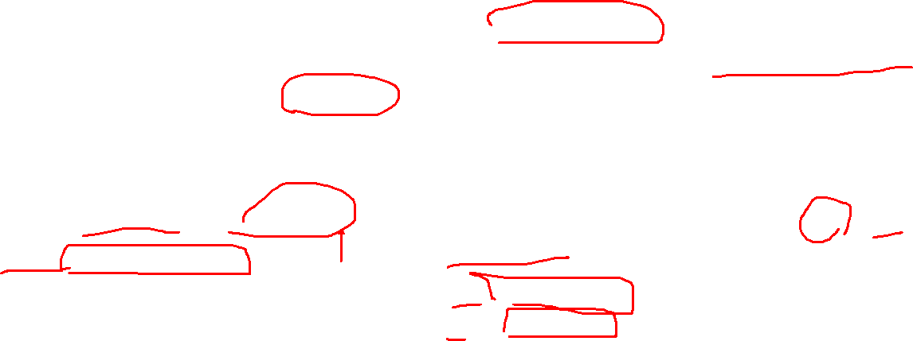

PHP constant : define()
Use the define() function to create a constant. It defines constant at run time. Let's see the syntax of define() function in PHP.
define (name, value, case-insensitive)
case-insensitive: Specifies whether a constant is case-insensitive. Default value is false. It means it is case sensitive by default
Constant1.php <?php define("MESSAGE","Hello PHP"); echo MESSAGE; ?>
Constant2.php <?php define("MESSAGE","Hello PHP",true);//not case sensitive echo MESSAGE, "</br>"; echo message; ?>

Slide 13
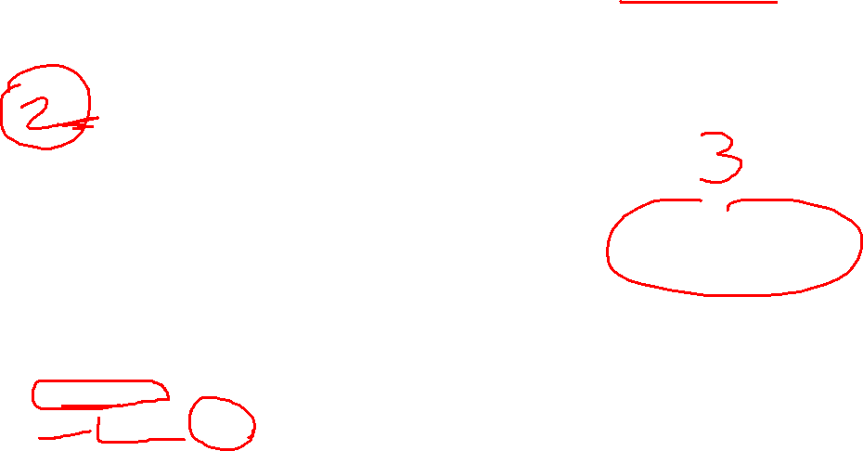
PHP constant : const keyword and constant function()
PHP introduced a keyword const to create a constant. The const keyword defines constants at compile time. It is a language construct, not a function. The constant defined using const keyword are case-sensitive.
<?php const MESSAGE="Hello const by PHP"; echo MESSAGE; ?>
There is another way to print the value of constants using constant() function instead of using the echo statement
<?php define("MSG", "Hello"); echo MSG, "</br>"; echo constant("MSG"); //both are similar ?>

Slide 14
PHP Data Types
PHP data types are used to hold different types of data or values. PHP supports 8 primitive data types that can be categorized further in 3 types:
Scalar Types (predefined)
Compound Types (user-defined)
Special Types

Slide 15
PHP Data Types : Scalar Types
PHP Data Types: Scalar Types
It holds only single value. There are 4 scalar data types in PHP.
boolean
integer
float
string
PHP Data Types: Compound Types
It can hold multiple values. There are 2 compound data types in PHP.
array
Object
PHP Data Types: Special Types
There are 2 special data types in PHP.
resource
NULL

Slide 16
PHP Data Types : Scalar Types
PHP Data Types: Scalar Types
It holds only single value. There are 4 scalar data types in PHP.
boolean
integer
float
string
PHP Data Types: Compound Types
It can hold multiple values. There are 2 compound data types in PHP.
array
Object
PHP Data Types: Special Types
There are 2 special data types in PHP.
resource
NULL

Slide 17
Scalar Types: boolean
Booleans are the simplest data type works like switch. It holds only two values: TRUE (1) or FALSE (0). It is often used with conditional statements. If the condition is correct, it returns TRUE otherwise FALSE
<?php if (TRUE) echo “This condition is TRUE.”; if (FALSE) echo “This condition is FALSE.”; ?>

Slide 18
Scalar Types: integer
Rules for integer:
An integer can be either positive or negative.
An integer must not contain decimal point.
Integer can be decimal (base 10), octal (base 8), or hexadecimal (base 16).
The range of an integer must be lie between 2,147,483,648 and 2,147,483,647 i.e., -2^31 to 2^31.
Note: Another important thing to know is that even if 4 * 2.5 is 10, the result is stored as float, because one of the operands is a float (2.5).
<?php $dec1 = 34; $oct1 = 0243; $hexa1 = 0x45; echo "Decimal number: " .$dec1. "</br>"; echo "Octal number: " .$oct1. "</br>"; echo "HexaDecimal number: " .$hexa1. "</br>"; ?>

Slide 19
Scalar Types: integer
Rules for integer:
An integer can be either positive or negative.
An integer must not contain decimal point.
Integer can be decimal (base 10), octal (base 8), or hexadecimal (base 16).
The range of an integer must be lie between 2,147,483,648 and 2,147,483,647 i.e., -2^31 to 2^31.
<?php $dec1 = 34; $oct1 = 0243; $hexa1 = 0x45; echo "Decimal number: " .$dec1. "</br>"; echo "Octal number: " .$oct1. "</br>"; echo "HexaDecimal number: " .$hexa1. "</br>"; ?>

Slide 20
Scalar Types: integer
PHP has the following predefined constants for integers:
PHP_INT_MAX - The largest integer supported
PHP_INT_MIN - The smallest integer supported
PHP_INT_SIZE - The size of an integer in bytes
PHP has the following functions to check if the type of a variable is integer:
is_int()
is_integer() - alias of is_int()
<?php $x= 5985; var_dump(is_int($x)); ?>

Slide 21
Scalar Types: Float
A float is a number with a decimal point or a number in exponential form.
2.0, 256.4, 10.358, 7.64E+5, 5.56E-5 are all floats.
PHP has the following predefined constants for floats (from PHP 7.2):
PHP_FLOAT_MAX - The largest representable floating point number
PHP_FLOAT_MIN - The smallest representable positive floating point number
PHP_FLOAT_MAX - The smallest representable negative floating point number
PHP has the following functions to check if the type of a variable is float:
is_float()
is_double() - alias of is_float()
<?php $x= 10.365; var_dump(is_float($x)); ?>

Slide 22
PHP Infinity
A numeric value that is larger than PHP_FLOAT_MAX is considered infinite.
PHP has the following functions to check if a numeric value is finite or infinite:
is_finite()
is_infinite()
However, the PHP var_dump() function returns the data type and value:
Example
<?php $x= 1.9e411; var_dump($x); ?>

Slide 23
PHP Numeral strings
The PHP is_numeric() function can be used to find whether a variable is numeric. The function returns true if the variable is a number or a numeric string, false otherwise.
Example
Check if the variable is numeric:
<?php $x = 5985; var_dump(is_numeric($x)); $x = "5985"; var_dump(is_numeric($x)); $x = "59.85" + 100; var_dump(is_numeric($x)); $x = "Hello"; var_dump(is_numeric($x)); ?>

Slide 24
PHP strings
String values must be enclosed either within single quotes or in double quotes. But both are treated differently. To clarify this, see the example below:
Example
Check if the variable is numeric:
<?php $company = "SQUAD"; //both single and double quote statements will treat different echo "Hello $company"; echo "</br>"; echo 'Hello $company'; ?>

Slide 25
PHP Array
An array is a compound data type. It can store multiple values of same data type in a single variable
<?php $bikes = array ("Royal Enfield", "Yamaha", "KTM"); var_dump($bikes); //the var_dump() function returns the datatype and values echo "</br>"; echo "Array Element1: $bikes[0] </br>"; echo "Array Element2: $bikes[1] </br>"; echo "Array Element3: $bikes[2] </br>"; ?>

Slide 26
PHP Operators
Operators are used to perform operations on variables and values. PHP divides the operators in the following groups:
Arithmetic operators
Assignment operators
Comparison operators
Increment/Decrement operators
Logical operators
String operators
Array operators
Conditional assignment operators

Slide 27
PHP Operators: Arithematic
The PHP arithmetic operators are used with numeric values to perform common arithmetical operations, such as addition, subtraction, multiplication etc.
Operator | Name | Example | Result
+ | Addition | $x + $y | Sum of $x and $y
- | Subtraction | $x - $y | Difference of $x and $y
* | Multiplication | $x * $y | Product of $x and $y
/ | Division | $x / $y | Quotient of $x and $y
% | Modulus | $x % $y | Remainder of $x divided by $y
** | Exponentiation | $x ** $y | Result of raising $x to the $y'th power

Slide 28
PHP Operators: Assignment
The PHP assignment operators are used with numeric values to write a value to a variable
Assignment | Same as... | Description
x = y | x = y | The left operand gets set to the value of the expression on the right
x += y | x = x + y | Addition
x -= y | x = x - y | Subtraction
x *= y | x = x * y | Multiplication
x /= y | x = x / y | Division
x %= y | x = x % y | Modulus

Slide 29
PHP Operators: Comparison Operators
The PHP comparison operators are used to compare two values (number or string)
Operator | Name | Example | Result
== | Equal | $x == $y | Returns true if $x is equal to $y
=== | Identical | $x === $y | Returns true if $x is equal to $y, and they are of the same type
!= | Not equal | $x != $y | Returns true if $x is not equal to $y
<> | Not equal | $x <> $y | Returns true if $x is not equal to $y
!== | Not identical | $x !== $y | Returns true if $x is not equal to $y, or they are not of the same type
> | Greater than | $x > $y | Returns true if $x is greater than $y
< | Less than | $x < $y | Returns true if $x is less than $y
>= | Greater than or equal to | $x >= $y | Returns true if $x is greater than or equal to $y
<= | Less than or equal to | $x <= $y | Returns true if $x is less than or equal to $y
<=> | Spaceship | $x <=> $y | Returns an integer less than, equal to, or greater than zero, depending on if $x is less than, equal to, or greater than $y. Introduced in PHP 7.

Slide 30
PHP Operators: Increment and Decrement Operators
Operator | Name | Description
++$x | Pre-increment | Increments $x by one, then returns $x
$x++ | Post-increment | Returns $x, then increments $x by one
--$x | Pre-decrement | Decrements $x by one, then returns $x
$x-- | Post-decrement | Returns $x, then decrements $x by one

Slide 31
PHP Operators: String Operators
Operator | Name | Example | Result
. | Concatenation | $txt1 . $txt2 | Concatenation of $txt1 and $txt2
.= | Concatenation assignment | $txt1 .= $txt2 | Appends $txt2 to $txt1

Slide 32
PHP Operators: Conditional Assignment Operators
The PHP conditional assignment operators are used to set a value depending on conditions
Operator | Name | Example | Result
?: | Ternary | $x= expr1 ? expr2 : expr3 | Returns the value of $x. The value of $x is expr2 if expr1 = TRUE. The value of $x is expr3 if expr1 = FALSE
?? | Null coalescing | $x = expr1 ?? expr2 | Returns the value of $x. The value of $x is expr1 if expr1 exists, and is not NULL. If expr1 does not exist, or is NULL, the value of $x is expr2. Introduced in PHP 7

Slide 33
PHP Control Statements
PHP if else statement is used to test condition. There are various ways to use if statement in PHP.
if
if-else
if-else-if
nested if

Slide 34
PHP if, if else, if–else-if : examples
<?php
$num=12;
if($num<100){
echo "$num is less than 100";
}
?>
<?php
$num=12;
if($num%2==0){
echo "$num is even number";
}else{
echo "$num is odd number";
}
?>

Slide 35
PHP Switch Statement:
The default is an optional statement. Even it is not important, that default must always be the last statement.
There can be only one default in a switch statement. More than one default may lead to a Fatal eraror.
Each case can have a break statement, which is used to terminate the sequence of statement. The break statement is optional to use in switch. If break is not used, all the statements will execute after finding matched case value.
PHP allows you to use number, character, string, as well as functions in switch expression.
Nesting of switch statements is allowed, but it makes the program more complex and less readable.
You can use semicolon (;) instead of colon (:). It will not generate any error.

Slide 36
PHP switch: examples
$num=20;
switch($num){
case 10:
echo("number is equals to 10");
break;
case 20:
echo("number is equal to 20");
break;
case 30:
echo("number is equal to 30");
break;
default:
echo("number is not equal to 10, 20 or 30");
}
?>

Slide 37
PHP for loop and for each loop: examples
PHP for loop can be used to traverse set of code for the specified number of times.
PHP for each loop is used to traverse array elements.
Example of for loop
<?php
$i = 1; //infinite loop
for (;;) {
echo $i++;
echo "</br>";
}
?>
Example of for each loop
<?php
$colors = array("red", "green", "blue", "yellow");
foreach ($colors as $value) {
echo "$value <br>";
}
?>

Slide 38
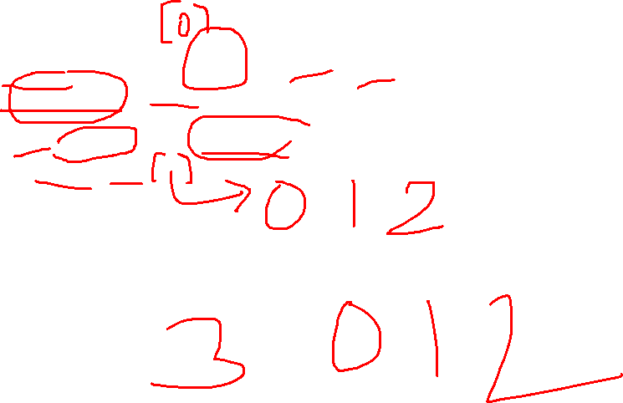
PHP for loop and for each loop: examples
Example 3 to print indexed array elements using foreach loop
<?php $cars = array("Volvo", "BMW", "Toyota"); $arrlength = count($cars); for($x = 0; $x < $arrlength; $x++) { echo $cars[$x]; echo "<br>"; } ?>

Slide 39
PHP for loop and for each loop: examples
Example 3 to print associative array elements using foreach loop
<?php
$age = array("Peter"=>"35", "Ben"=>"37", "Joe"=>"43");
echo "Peter is " . $age['Peter'] . " years old.";
?>
Example 4 to print multi-dimentional array elements using foreach loop
<?php
$cars = array (
array("Volvo",22,18),
array("BMW",15,13),
array("Saab",5,2),
array("Land Rover",17,15)
);
echo $cars[0][0].": In stock: ".$cars[0][1].", sold: ".$cars[0][2].".<br>";
echo $cars[1][0].": In stock: ".$cars[1][1].", sold: ".$cars[1][2].".<br>";
echo $cars[2][0].": In stock: ".$cars[2][1].", sold: ".$cars[2][2].".<br>";
echo $cars[3][0].": In stock: ".$cars[3][1].", sold: ".$cars[3][2].".<br>";
?>

Slide 40
PHP while loop: examples
Example 1 while loop example
<?php
$n=1;
while($n<=10){
echo "$n<br/>";
$n++;
} ?>
Example 2 infinite while loop
<?php
while (true) {
echo "Hello Folks!";
echo "</br>";
}
?>

Slide 41
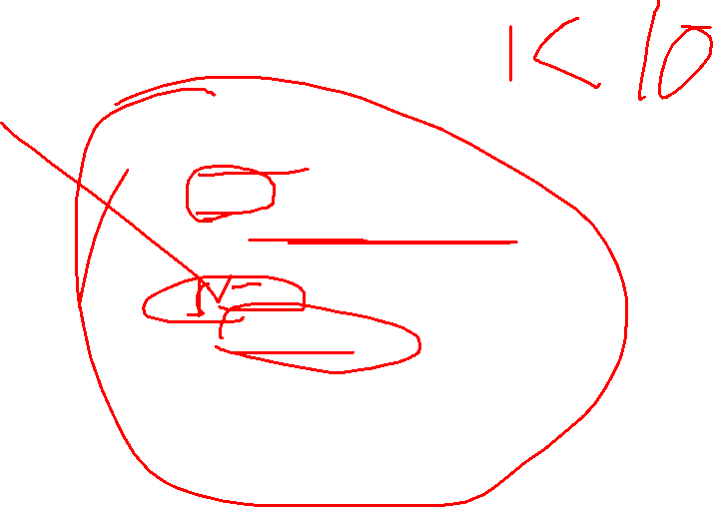
PHP do while loop: example
Example 3 do while loop example
<?php
$n=1;
do{
echo "$n<br/>";
$n++;
}while($n<=10);
?>
Example 4 while loop
<?php
$x = 1;
do {
echo "1 is not greater than 10.";
echo "</br>";
$x++;
} while ($x > 10);
echo $x;
?>
NOTE: In example 2, it will increment the value of $x at least once. Because the given condition is false

Slide 42

PHP do while loop: difference
while Loop | do-while loop
The while loop is also named as entry control loop. | The do-while loop is also named as exit control loop.
The body of the loop does not execute if the condition is false. | The body of the loop executes at least once, even if the condition is false.
Condition checks first, and then block of statements executes. | Block of statements executes first and then condition checks.
This loop does not use a semicolon to terminate the loop. | Do-while loop use semicolon to terminate the loop.

Slide 43

PHP break statement examples
Example 1
<?php
for($i=1;$i<=10;$i++){
echo "$i <br/>";
if($i==5){
break;
}
}
?>
Example 2
The PHP break statement breaks the execution of inner loop only.
<?php
for($i=1;$i<=3;$i++){
for($j=1;$j<=3;$j++){
echo "$i $j<br/>";
if($i==2 && $j==2){
break;
}
}
}
?>

Slide 44

PHP continue statement examples
Example 1
<?php
//outer loop
for ($i =1; $i<=3; $i++) {
//inner loop
for ($j=1; $j<=3; $j++) {
if (!($i == $j) ) {
continue; //skip when i and j does not have same values
}
echo $i.$j;
echo "</br>";
}
}
?>
Example 2
<?php
$number = array ("One", "Two", "Three", "Stop", "Four");
foreach ($number as $element) {
if ($element == "Stop") {
continue;
}
echo "$element </br>";
}
?>

Slide 45
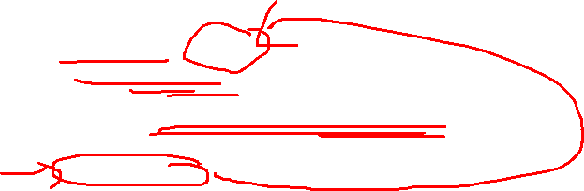
PHP functions: Parameterized Functions
Example 1
<?php
//Adding two numbers
function add($x, $y) {
$sum = $x + $y;
echo "Sum of two numbers is = $sum <br><br>";
}
add(467, 943);
//Subtracting two numbers
function sub($x, $y) {
$diff = $x - $y;
echo "Difference between two numbers is = $diff";
}
sub(943, 467);
?>

Slide 46
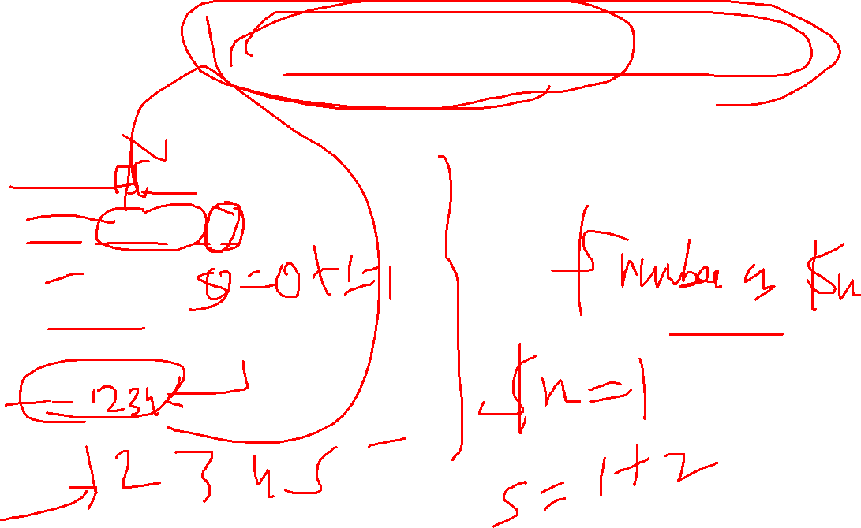
PHP functions: variable length argument function
Example 1
<?php
function add(...$numbers) {
$sum = 0;
foreach ($numbers as $n) {
$sum += $n;
}
return $sum;
}
echo add(1, 2, 3, 4);
?>

Slide 47
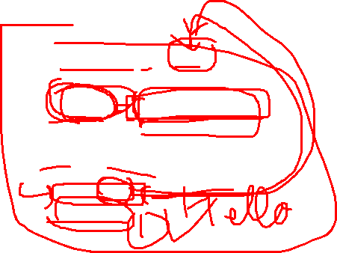
PHP functions: Call by Value
Example 1
<?php
function adder($str2)
{
$str2 .= 'Call By Value';
}
$str = 'Hello ';
adder($str);
echo $str;
?>
Example 2
<?php
function increment($i)
{
$i++;
}
$i = 10;
increment($i);
echo $i;
?>

Slide 48

PHP functions: Call by Reference
Example 1
<?php
function adder(&$str2)
{
$str2 .= 'Call By Reference';
}
$str = ’Hello ';
adder($str);
echo $str;
?>
Example 2
<?php
function increment(&$i)
{
$i++;
}
$i = 10;
increment($i);
echo $i;
?>

Slide 49
PHP functions: Recursive Function
Example 1
<?php
function display($number) {
if($number<=5)
{
echo "$number <br/>";
display($number+1);
}
}
display(1);
?>

Slide 50
Assignment 1
Write a program to create Chess Board in PHP using for loop
Write a program to calculate Electricity bill in PHP
Write a simple calculator program in PHP using switch case
Write a PHP program to check if a person is eligible to vote

Slide 51
Assignment 2
Implement following PHP String and Array functions:
strtolower()
explode()
strpos()
ucfirst()
substr()
array_merge()
array_rand()
array_slice()
array_merge_recursive()
array_reverse()

Slide 52
THANK YOU..

